Slide 1
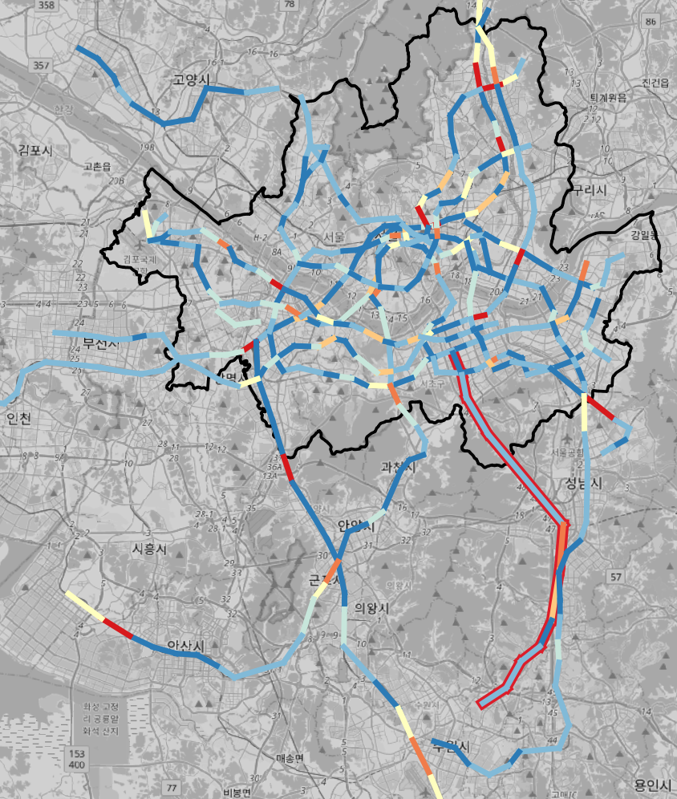
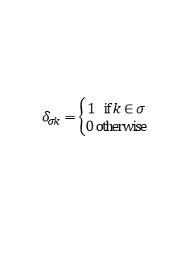



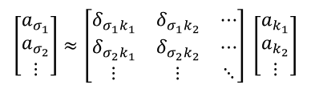





Modeling and performance evaluation of a recursive logit model with non-link-additive attributes Researcher: Sedong Moon
What is the problem?
In a recursive logit (RL) model, attributes used in the utility function must be link-additive
A new methodology is needed to incorporate non-link-additive attributes in a RL model
Performances of RL models with non-link-additive attributes needs to be evaluated
Why is this problem important?
Analyzing intermodal trip behaviors in a multimodal network is important
Mode and route choices should be formulated simultaneously when modeling intermodal trip behaviors
RL models can formulate mode and route choices simultaneously
However, non-link-additive attributes could not be considered in previous RL models
How can we solve this problem?
Link-additive approximation of non-link-additive path attributes
Approximate a path attribute as a linear combination of link attributes
Approximated link-additive attributes can be calculated by multiplying the Moore-Penrose Pseudoinverse of the linear combination matrix and the path attribute
Incorporate the approximated link-additive attributes to the utility function
Limitations of previous RL models
Contribution of this study
Only link-additive attributes can be used
(constraint to variable selection)
Develop RL model with non-link-additive attributes
(link-additive approximation)
Performance of a RL model with non-link-additive attributes should be evaluated
(prediction time, goodness of fit, …)
Compare performances of RL models with and without non-link-additive attributes
Link-additive approximation
RL model with
non-link additive attribute
$$\left[\begin{matrix}a_{σ_{1}} \\ a_{σ_{2}} \\ ⋮\end{matrix}\right]≈\left[\begin{matrix}δ_{σ_{1}k_{1}} & δ_{σ_{1}k_{2}} & ⋯ \\ δ_{σ_{2}k_{1}} & δ_{σ_{2}k_{2}} & ⋯ \\ ⋮ & ⋮ & ⋱\end{matrix}\right] \left[\begin{matrix}a_{k_{1}} \\ a_{k_{2}} \\ ⋮\end{matrix}\right]$$
e.g.
$$v_{n}\left(a | k\right) =β_{Const}+β_{TT}TT+β_{Tr}δ_{Tr}+β_{F}\hat{F_{link}}$$
$$A_{σ}$$
$$Δ$$
$$A_{k}$$
$v_{n}\left(a | k\right)$: utility function
$β_{Const}$: constant
$β_{TT}$, $β_{Tr}$, $β_{F}$: coefficients
$TT$: link travel time
$δ_{Tr}$: number of transfers
$\hat{F_{link}}$: approximated link-additive fare
$a_{σ_{p}}$: path attribute of path $σ_{p}$
$a_{k_{l}}$: link attribute of link $k_{l}$
$$δ_{σk}=\left\{\begin{aligned}1 if k∈σ \\ 0 otherwise\end{aligned}\right.$$
$A_{k}^{∗}$=$Δ^{+}A_{σ}$
$A_{k}^{∗}\text{: }$ Approximated link-additive attribute matrix
$Δ^{+}$: pseudoinverse of $Δ$
Link-additive
approximation results
What is key contribution?
Propose a RL model with better performances compared to previous models by incorporating non-link-additive attributes
Analyze intermodal trip behaviors with the proposed RL model with non-link-additive attributes

